Slide 1
For Live Session Assignment (FLS)
Unit 9

Slide 2
Quick Quiz Questions

Slide 3
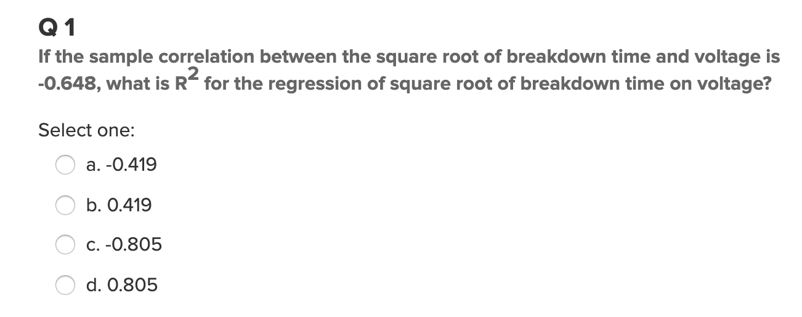
Question 1:

Slide 4
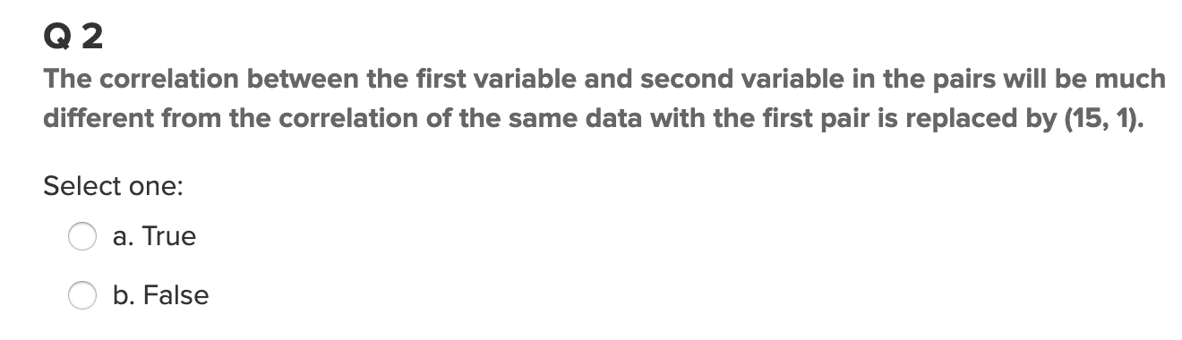
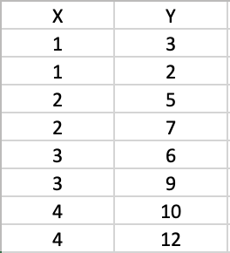
Question 2:

Slide 5
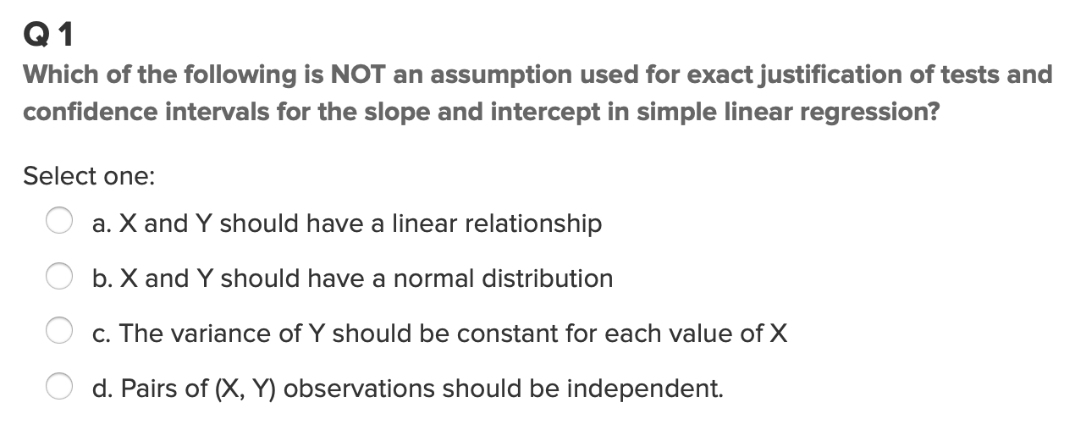
Question 3:

Slide 6
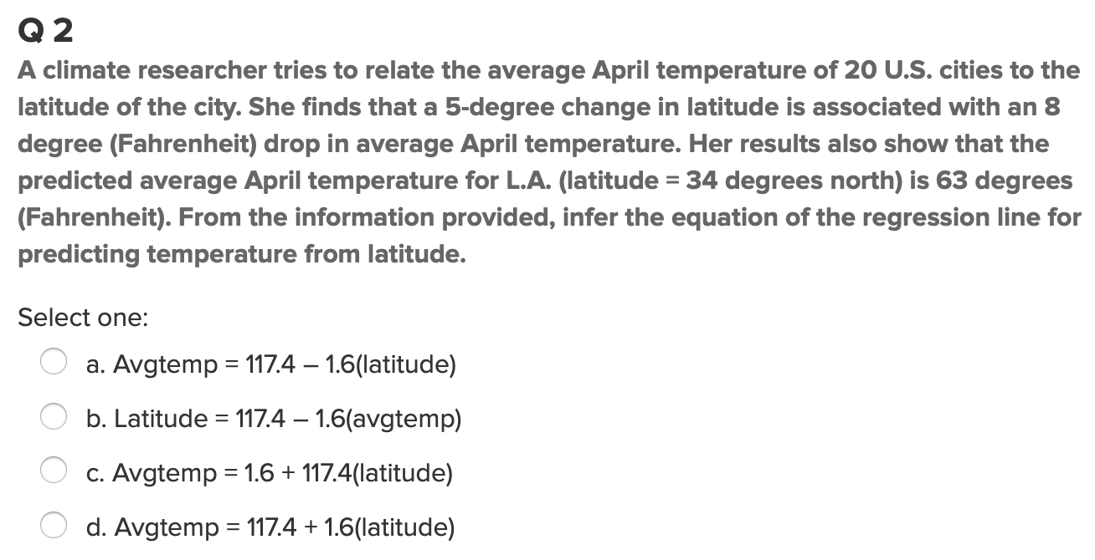
Question 4:

Slide 7
End Quick Quiz Questions

Slide 8
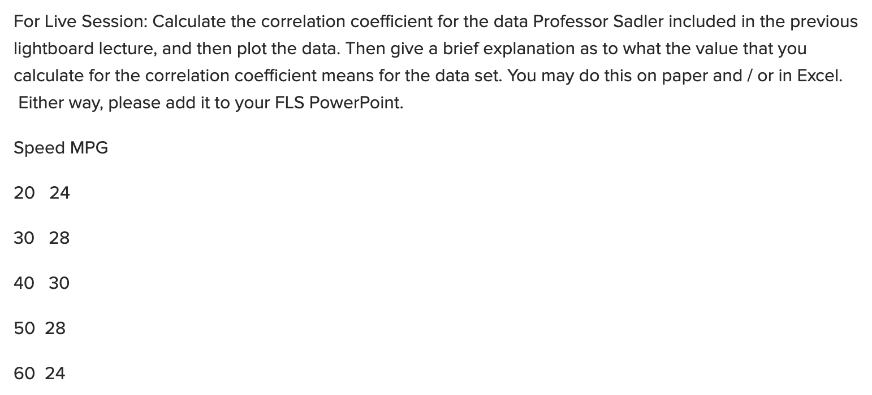
Question 1: From 9.8.4

Slide 9

Question 2: From 9.9.3

Slide 10
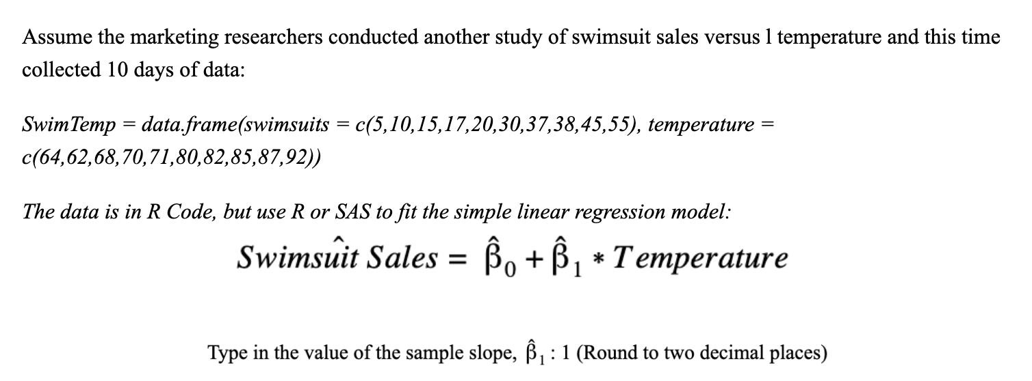
Question 3: From 9.18.4

Slide 11

Question 4: From 9.21.4

Slide 12
Question 5: Takeaways!
Please provide at least 4 takeaways from this section and any questions that you may have. These questions will help design the live session for this unit.
This question will be the last question of every For Live Session Assignment. The idea is that this deck will serve as a document that you can reference in the future to remember what was covered in this section. For instance, this may come in handy for the Capstone and will hopefully become useful in your career. Most immediately, it may become handy as a quick reference for your Midterm and Final! Some students find it very useful and spend a few slides summarizing the asynch material while others learn different ways and only had the minimum 4 takeaways. Either is fine and will earn you full credit for this question.

Slide 13
Question 6: Questions!
Please provide any question or topics of discussion that came up in this Unit! These will help help us optimize our live session for maximum learning and takeaways!
This question will be the last question of every For Live Session Assignment. The idea is that this deck will serve as a document that you can reference in the future to remember what was covered in this section. For instance, this may come in handy for the Capstone and will hopefully become useful in your career. Most immediately, it may become handy as a quick reference for your Midterm and Final! Some students find it very useful and spend a few slides summarizing the asynch material while others learn different ways and only had the minimum 4 takeaways. Either is fine and will earn you full credit for this question.

Slide 14
End For Live Session Assignment Unit 9!

